Slide 1
Fáilte/Welcome!
PPES Orientation meeting
19 September 2023
Prof Elaine Moriarty
Academic Director PPES programme

Slide 2
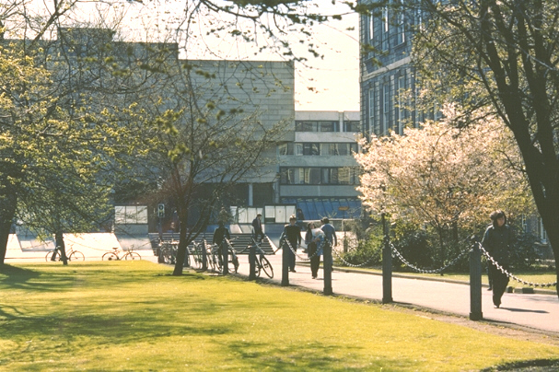
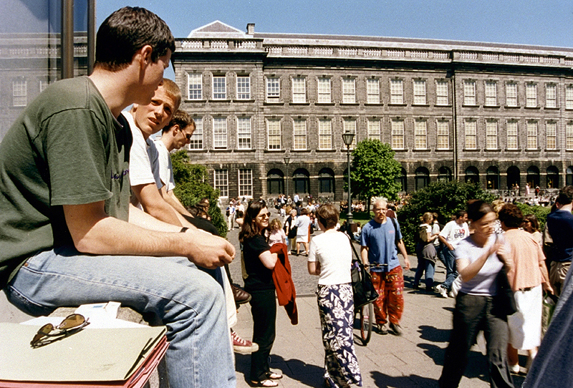
Trinity College… Founded in 1592
A University of Global Consequence
Leading Irish Research University
Global Recognition
Ranked 1st in Ireland and 101st in the World (QS World University Ranking)
Notes:
Trinity College Dublin was created by royal charter in 1592
It is recognised globally as Ireland’s leading research university
Ranked 1st in Ireland and 129th in the World (QS 2014 71st in world and 25th in Europe)

Slide 3
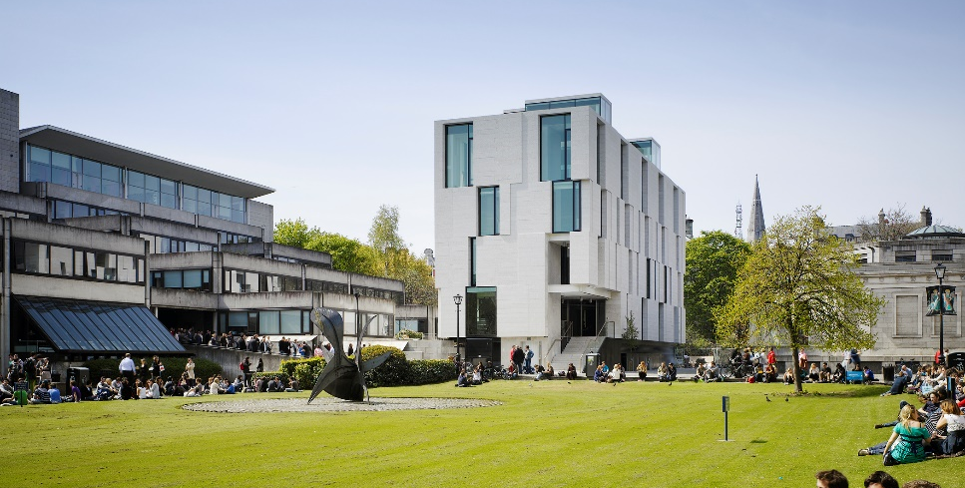
PPES - Philosophy, Political Science, Economics and Sociology
Philosophy | 5th floor, Arts Building
Political Science | 4th floor, 2-3 College Green (between Starbucks and Costa on Dame St)
Economics | 3rd floor, Arts Building
Sociology | 3rd floor, 2-3 College Green (between Starbucks and Costa on Dame St)
School of Social Sciences and Philosophy
Notes:
Strong international research reputation
Excellent links to Irish and global organisations in the private, public and voluntary sector
Range of Undergraduate programmes: BESS, Single honours Philosophy, range of joint honours degrees

Slide 4
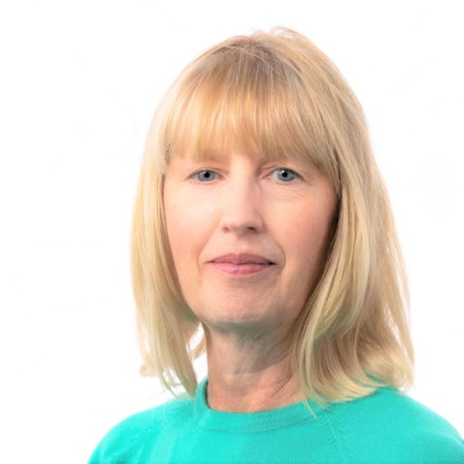
PPES Programme Administration
Office: Room 3023, Level 3, Arts Building
Administrator: Martina Ní Chochláin
Email: ppes@tcd.ie (giving your student number)
Open every day (8-12.45 and 2-3.15)
email/call by in person
Martina Ní Chochláin
Annual/Re-assessment Progression & Publication of Results Mark Changes Timetable Course Regulations | Management of Course Handbook/Web Site Transcripts of Results General Course Queries – If I can’t help you personally, I’ll know someone who can!

Slide 5
Academic Calendar Week | Week beginning | 2023/24 Academic Year Calendar |  | Term / Semester
 |  | UG continuing years / PG all years | UG new first years
1 | 28-Aug-23 | Reassessment * (Semesters 1 & 2 of 2022/23) |  | ←Michaelmas Term begins/Semester 1 begins
2 | 04-Sep-23 | Orientation (Postgraduate, Visiting & Erasmus); Marking/Results
3 | 11-Sep-23 | Teaching and Learning |  | ←Michaelmas teaching term begins
4 | 18-Sep-23 | Teaching and Learning | Orientation (JF UG)
5 | 25-Sep-23 | Teaching and Learning | Teaching and Learning
6 | 02-Oct-23 | Teaching and Learning | Teaching and Learning
7 | 09-Oct-23 | Teaching and Learning | Teaching and Learning
8 | 16-Oct-23 | Teaching and Learning | Teaching and Learning
9 | 23-Oct-23 | Study/Review | Study/Review
10 | 30-Oct-23 | Teaching and Learning (Monday, Public Holiday) | Teaching and Learning (Monday, Public Holiday)
11 | 06-Nov-23 | Teaching and Learning | Teaching and Learning
12 | 13-Nov-23 | Teaching and Learning | Teaching and Learning
13 | 20-Nov-23 | Teaching and Learning | Teaching and Learning
14 | 27-Nov-23 | Teaching and Learning | Teaching and Learning
15 | 04-Dec-23 | Revision | Revision
16 | 11-Dec-23 | Assessment * | Assessment * ~ | ←Michaelmas term ends Sunday 17 December 2023/Semester 1 ends
17 | 18-Dec-23 | Christmas Period - College closed 22 December 2023 to 1 January 2024 inclusive | Christmas Period - College closed 22 December 2023 to 1 January 2024 inclusive
18 | 25-Dec-23
19 | 01-Jan-24
20 | 08-Jan-24 | Foundation Scholarship Examinations ^ | Foundation Scholarship Examinations ^ | ←Hilary Term begins/Semester 2 begins
21 | 15-Jan-24 | Marking/Results | Marking/Results
22 | 22-Jan-24 | Teaching and Learning | Teaching and Learning | ←Hilary teaching term begins
23 | 29-Jan-24 | Teaching and Learning | Teaching and Learning
24 | 05-Feb-24 | Teaching and Learning (Monday, Public Holiday) | Teaching and Learning (Monday, Public Holiday)
25 | 12-Feb-24 | Teaching and Learning | Teaching and Learning
26 | 19-Feb-24 | Teaching and Learning | Teaching and Learning
27 | 26-Feb-24 | Teaching and Learning | Teaching and Learning
28 | 04-Mar-24 | Study/Review | Study/Review
29 | 11-Mar-24 | Teaching and Learning | Teaching and Learning
30 | 18-Mar-24 | Teaching and Learning (Monday, Public Holiday) | Teaching and Learning (Monday, Public Holiday)
31 | 25-Mar-24 | Teaching and Learning (Friday, Good Friday) | Teaching and Learning (Friday, Good Friday)
32 | 01-Apr-24 | Teaching and Learning (Monday, Easter Monday) | Teaching and Learning (Monday, Easter Monday)
33 | 08-Apr-24 | Teaching and Learning | Teaching and Learning
34 | 15-Apr-24 | Revision | Revision | ←Hilary Term ends Sunday 21 April 2024
35 | 22-Apr-24 | Trinity Week (Monday, Trinity Monday) | Trinity Week (Monday, Trinity Monday) | ←Trinity Term begins
36 | 29-Apr-24 | Assessment * | Assessment *
37 | 06-May-24 | Marking/Results (Monday, Public Holiday) | Marking/Results (Monday, Public Holiday)
38 | 13-May-24 | Marking/Results | Marking/Results
39 | 20-May-24 | Marking/Results | Marking/Results
Notes:
You will have seen the college calendar during general orientation or it is available on the TCD website. I would like to draw attention to a couple of things:
You have two teaching terms known in Trinty as Michaelmas and Hilary terms.
You will be automatically enrolled in your modules as a PPES Fresher.
You have a study week in each teaching term which can be used for catching up, reading or sometimes modules set term tests around these weeks.
Michaelmas Term: week starting September 25, 2023
Hilary Term: week starting 22 January, 2024
There are two formal exam periods:
Michaelmas Term: week starting December 11, 2023.
Hilary Term: week starting April 29, 2024
Note: One week of revision directly after end of teaching and before start of exams (Michaelmas Term). Two weeks of revision directly after end of teaching and before start of exams (Hilary Term)
However, please note that each module has their own unique assessment format – these can include continuous assessment in the form of essays, tutorial participation, and /or scheduled exams.

Slide 6
Your college timetable
Your lectures and tutorials/seminars will be available on my.tcd.ie
Along with your module choices, it also contains information on where the lectures and seminars will take place
It may include optional courses that are available on learning about plagiarism and academic integrity; navigating the library; engaging with student development
Notes:
Please ensure today that you are registered for 60 ECTs for year 1 of your degree.
Ensure you are registered for relevant tutorials or seminars for each module that are enrolled in.

Slide 7
What is the Trinity PPES programme?
Philosophy
Sociology
Political Science
Economics
Notes:
Trinity’s PPES programme is the only university degree in Ireland where students can combine the study of philosophy, political science, economics and sociology. It provides an integrated multidisciplinary education in the social sciences and philosophy, with students studying four subjects that are central to understanding any society. It brings together some of the most important approaches to understanding the social and human world, developing skills suited to a range of future careers and activities
Philosophy If you are interested in questioning society’s basic assumptions and in analysing the moral, political, and religious questions at the heart of our culture, you will find philosophy a stimulating subject. Philosophy will train you to question your own assumptions and someone else’s, and to articulate your point of view carefully and thoughtfully. There has been a rich tradition of philosophical excellence at Trinity College since its foundation. Trinity’s department of philosophy is a close-knit, intellectual community of researchers, teachers and students which combines high-quality teaching with expansive research activity. Political Science It’s easy to think of political issues that we have opinions about. Should government tax the rich to achieve greater equality? Should it introduce ‘green taxes’ to help protect the environment? Such questions, along with analysis of political systems and how democracy works, are at the heart of the study of politics. Political science has been an important part of the curriculum since 1855. Today it is a vibrant, outwardlooking department which is recognised worldwide for its research work on the European Union, comparative politics, international relations and public opinion. Economics Many issues dominating the headlines are economic. For example why do certain countries enjoy high growth rates and what are the best ways to reduce poverty? Economics blends together theory, data and statistical techniques to help understand economic problems and to make policy recommendations which will hopefully improve society’s welfare and living standards. Economics has been an important part of Trinity’s curriculum since 1832. The department is committed to delivering the highest standards of teaching and has a strong research record, with a particular emphasis on applied economics. Sociology Sociology is foremost among the social sciences in studying social change and the consequences of human behaviour. With core themes such as migration, race and gender, conflict studies, digitalisation, identities and employment studies, sociology students gain a critical global perspective on a variety of social issues. There has been a strong tradition of sociological education at Trinity since the 1960s. The department is committed to advancing the understanding of society and to igniting the passion of our students through exceptional teaching and research

Slide 8
What you will study
Overview
1st Year (Junior Fresh)
2nd Year (Senior Fresh)
3rd Year (Junior Sophister)
4th Year (Senior Sophister)
60 ECTS
60 ECTS
60 ECTS
60 ECTS
Introduction to all four disciplines
Key foundational skills of your chosen discipline(s)
Specialisation allowing to choose areas of interest within 2nd year discipline(s)
Opportunity to study abroad
Specialisation in your chosen discipline(s)
Capstone project

Slide 9
1st Year (Junior Fresh)
2nd Year (Senior Fresh)
3rd Year (Junior Sophister)
4th Year (Senior Sophister)
In the Junior Fresh (first) year, you will take 60 ECTS worth of compulsory modules from within all four subjects:
Economics (including Mathematics and Statistics)
Philosophy
Political Science
Sociology

Slide 10
1st Year (Junior Fresh)
2nd Year (Senior Fresh)
3rd Year (Junior Sophister)
4th Year (Senior Sophister)
In Senior Fresh (second) year students take 60 ECTS from two or three of the four subjects:
20 ECTS in Subject 1, 20 ECTS in Subject 2 and 20 ECTS in Subject 3, dropping one of the four subjects taken in Junior Fresh year or
20 ECTS in Subject 1, 20 ECTS in Subject 2, 10 ECTS from any of the available modules within the programme structure and 10 ECTS of Trinity Electives, dropping two of the four subjects taken in Junior Fresh year, or
40 ECTS in Subject 1 and 20 ECTS in Subject 2, dropping two of the four subjects taken in Junior Fresh year.
40 ECTS in Subject 1, 10 ECTS from any of the available modules within the programme structure and 10 ECTS of Trinity Electives
Note: In order to continue with a Single Honor, students must take 40 ECTS in that subject in the Senior Fresh year.

Slide 11
1st Year (Junior Fresh)
2nd Year (Senior Fresh)
3rd Year (Junior Sophister)
4th Year (Senior Sophister)
Be mindful of
mandatory modules for specific degree pathways (see PPES handbook)
prerequisites for 3rd/4th year subjects (see PPES handbook) and their implications for your pathway opportunities
Study abroad prep: Application process for going abroad in the 3rd year.
See PPES Handbook for details on pathways, modules and prereqs!

Slide 12
1st Year (Junior Fresh)
2nd Year (Senior Fresh)
3rd Year (Junior Sophister)
4th Year (Senior Sophister)
In Junior and Senior Sophister year, students can pursue the following:
Single Honor in Philosophy; Political Science; Economics; Sociology
Joint Honor in Philosophy and Political Science; Philosophy and Economics; Philosophy and Sociology; Political Science and Economics; Political Science and Sociology; Sociology and Economics
Major/Minor
Major Economics (Minor Philosophy or Minor Political Science or Minor Sociology)
Major Philosophy (Minor Political Science or Minor Economics or Minor Sociology)
Major Political Science (Minor Philosophy or Minor Economics or Minor Sociology)
Major Sociology (Minor Philosophy or Minor Political Science or Minor Economics)
Notes:
Access Trinity Electives (10 ECTS) in 3rd year under single honor degree
Capstone project (20 ECTS) undertaken in all 4th years. Choice of which discipline to do it in for a joint degree.
Major / minor
Capstone in major
S1 40 + Capstone 20 -> 60 and 1 subject only, e.g. Major Sociology minor business: 60 ECTS from sociology including the capstone + 40 optionals
See BESS handbook for full details.

Slide 13
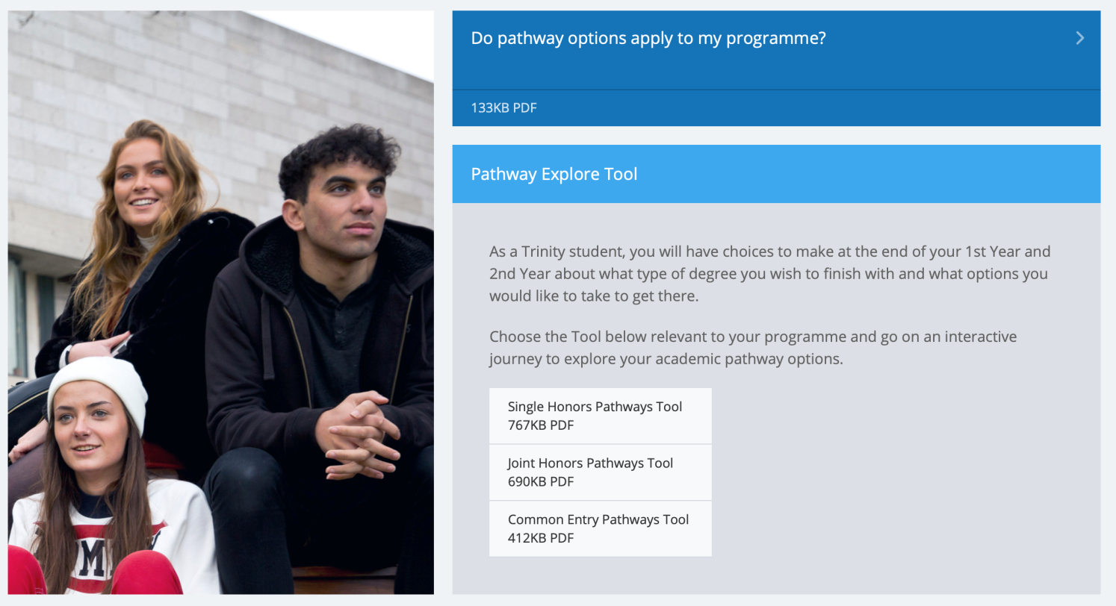
Pathway Explore Tool
https://www.tcd.ie/courses/undergraduate/your-trinity-pathways/

Slide 14
The Trinity Experience
https://www.tcd.ie/students/clubs-societies/
Wider student life is important, and PPES provides plenty of scope for engagement in a wide range of activities.
50 sports clubs, 120 societies.
Some societies seem particularly suited to PPES Students
DUBES – Dublin University Business & Economic Society | Political Science Society | Social Studies Society
AIESEC | Foresight | Enterprise Trinity
Upstart | Mature Students Society
Notes:
HOW MANY SOCIETIES
Foresight: business school: forum to meet businessmen
Enterprise: supports start ups
Upstart: entrepeneurs

Slide 15
We are here to help!
PPES website www.tcd.ie/ppes
PPES Handbook
PPES Administration and Director
Your Module Lecturers
Module Teaching Assistants
Your College Tutor
Student Learning Development
Mathematics Help Room
Notes:
Student Learning Development supports Trinity students reach their academic potential. We offer a range of services including individual appointments, workshops and skills events.
Mathematics Help Room -> school of math
https://maths.tcd.ie/outreach/helproom/

Slide 16
Important PPES Rules (1)
Attend your lectures and tutorials!
Lectures and tutorials are compulsory!
Students with significant level of absenteeism can be deemed non-satisfactory (“NS”) and prevented from sitting final examinations!
Some tests may take place during Michaelmas and Hilary Terms (e.g. in modules with continuous assessment).
Lecture, test and exam scheduling is done by central College and students are generally informed at the same time as academic staff
Notes:
Students with significant level of absenteeism can be deemed non-satisfactory (“NS”) and prevented from sitting final examinations

Slide 17
Important PPES Rules (2)
Keep updated and communicate properly
Check your college emails daily!
Only use your official college email address (…@tcd.ie)
You cannot expect response to private email accounts!
Be polite and respectful when writing emails to college staff
Write concise emails that state clearly your concern
Always provide your course and student ID in emails!
Configure a signature including your course name and student ID.

Slide 18
Important PPES Rules (3)
What to do if …
… you are ill for tests and/or examinations?
Absences are excused only with a medical certificate or equivalent (communicate with/via your College Tutor), need to do this immediately.
Absence is not the same as getting zero. If you fail to turn up to an exam you need to explain it formally to the college through your tutor.
The assumption is that if you sit an exam then you were healthy. Typically it is not possible to claim illness after an exam.

Slide 19
Important PPES Rules (4)
What to do if …
… you are unable to submit an assignment on schedule?
Contact your tutor and the lecturer concerned, preferably before the deadline.
… you are unable to attend a mandatory class?
Contact your tutor and the lecturer concerned, preferably before the class is taking place.

Slide 20
Next week
Two hours of lectures in each of the modules.
In the first lecture the requirements and rules of the module will be explained, so make sure you attend.
Usually, no seminars or tutorials in week 1 (but check module descriptions)
Seminar/tutorial groups assigned via SITS.
Only in exceptional cases, you can request a change of tutorial group by contacting the relevant departmental office (not the Course Office).

Slide 21
Next steps
Check your college email regularly (communication from the Course Office will be via your TCD email address only).
Maintain steady progress with your modules.
Get in contact with your College Tutor.
Get in contact with Student 2 Student (S2S).
Get to know your classmates. Be inclusive and have different friends.

Slide 22
Making your voices heard
PPES: student representative on the programme committee.
Students’ Union: class reps who meet with individual Department Heads on a regular basis.
Module evaluations by students: at the end of Hilary and Michaelmas terms. (http://www.tcd.ie/ssp/undergraduate/student-evaluations/YouSaid_WeDid.php)
Each year is invited to partake in a Course Evaluation Survey.
Problems with a module? – in general, if possible bring it up with the module lecturer in the first instance.
Individual/personal problems? – discuss with your College Tutor and there’s also the counselling service and peer-support offered by Student 2 Student (S2S).

Slide 23
And finally…. Enjoy your studies on the PPES Programme at Trinity College Dublin!

